Slide 1
Data Visualization Methods in Social Cognition
Courtney Chan
PSYC 6135 Data Visualization

Slide 2
What is Social Psychology and Social Cognition?
Social Psychology - how people's thoughts, feelings, and behaviors are influenced by the actual, imagined, or implied presence of others
Social Cognition - how we perceive, interpret, and remember information about ourselves and others
Schemas and stereotypes
Attributions
Stereotypes and biases
Automatic vs. controlled processing

Slide 3
Traditional Social Cognition Methods
Likert Scales
Self-report questionnaires
Feeling thermometers
Forced-choice questions
Open-ended responses
Physiological measures (e.g., heart rate, GSR)
Reaction time tasks (e.g., IAT, Stroop)
Economic games (e.g., ultimatum game, dictator game)

Slide 4
Implicit Methods in Social Cognition
Reverse Correlation
Allows researchers to examine mental representations
Mouse-tracking
Shows mental processes in decision-making

Slide 5
What is Reverse Correlation?
A data-driven method for visualizing mental representations of social categories (e.g., race, gender, trustworthiness)
Implicit stereotypes and mental representations of specific groups
Trait inferences (e.g., competence, warmth, danger)
Benefits:
Doesn't rely on self-report
Captures spontaneous cognitive associations

Slide 6
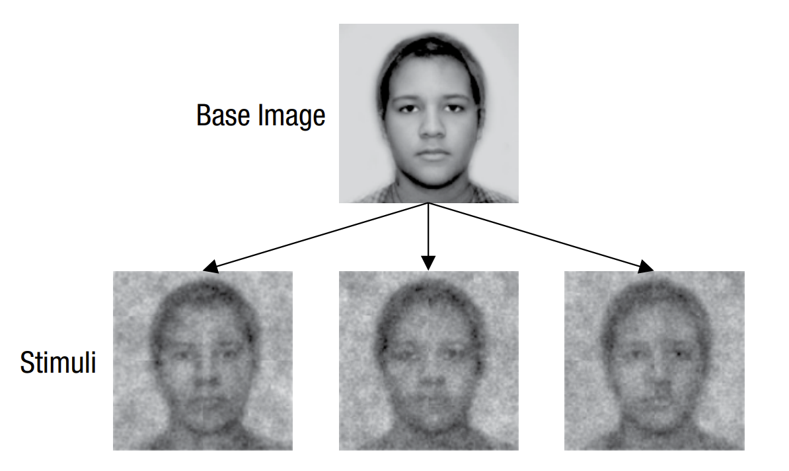
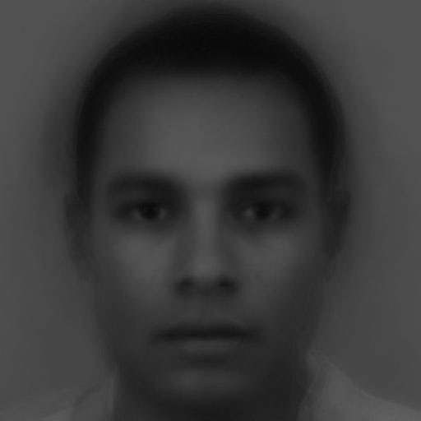
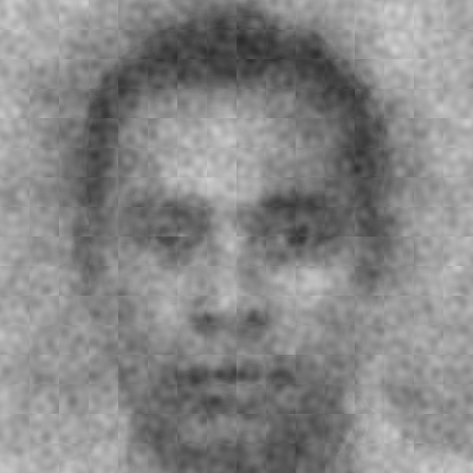
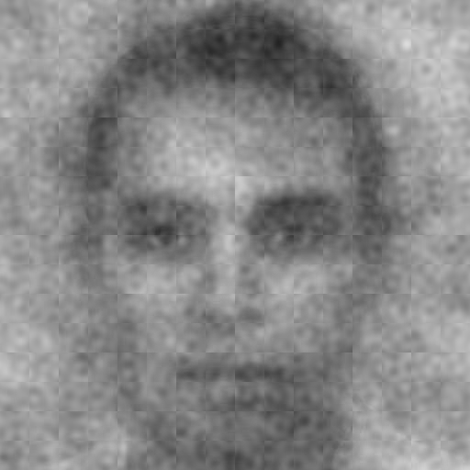
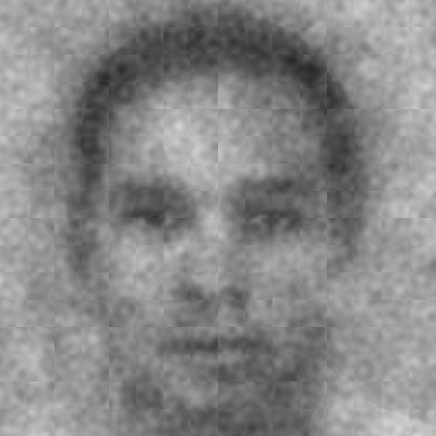
Reverse Correlation: How does it work?

Slide 7
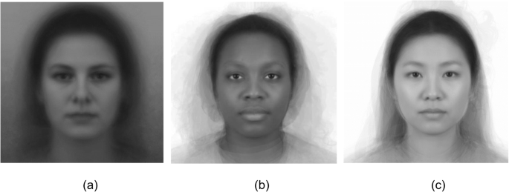
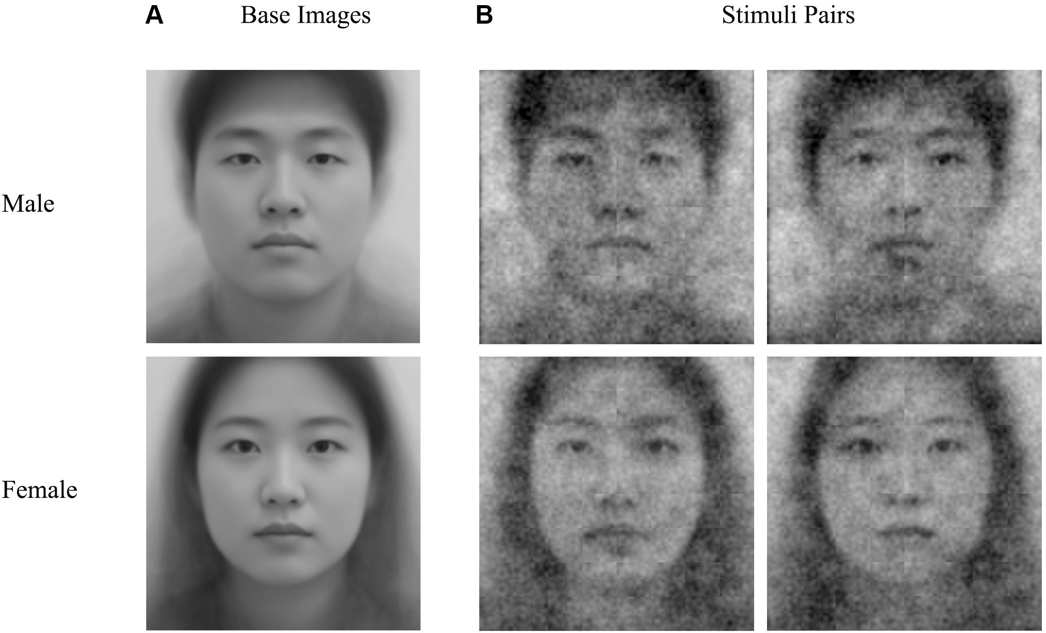
Sample base face images:
Base face images with noise overlay:

Slide 8
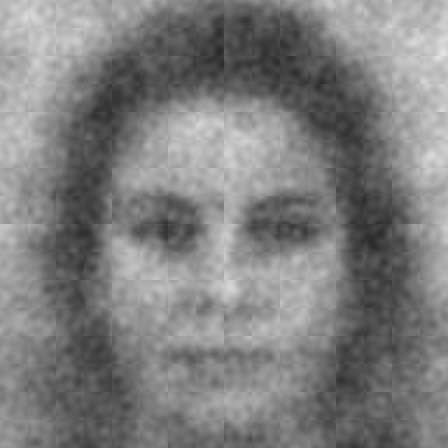
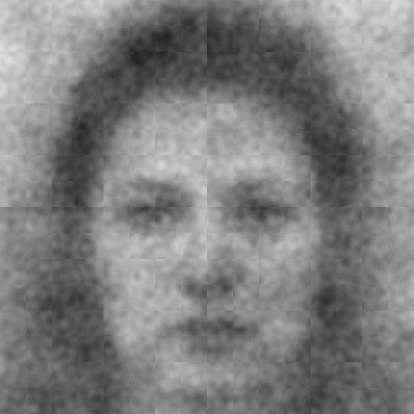
Confronter Condition
Choose the face that looks more like someone who would confront the person making the sexist comment.

Slide 9
Non-confronter Condition
Choose the face that looks less like someone who would confront the person making the sexist comment.

Slide 10
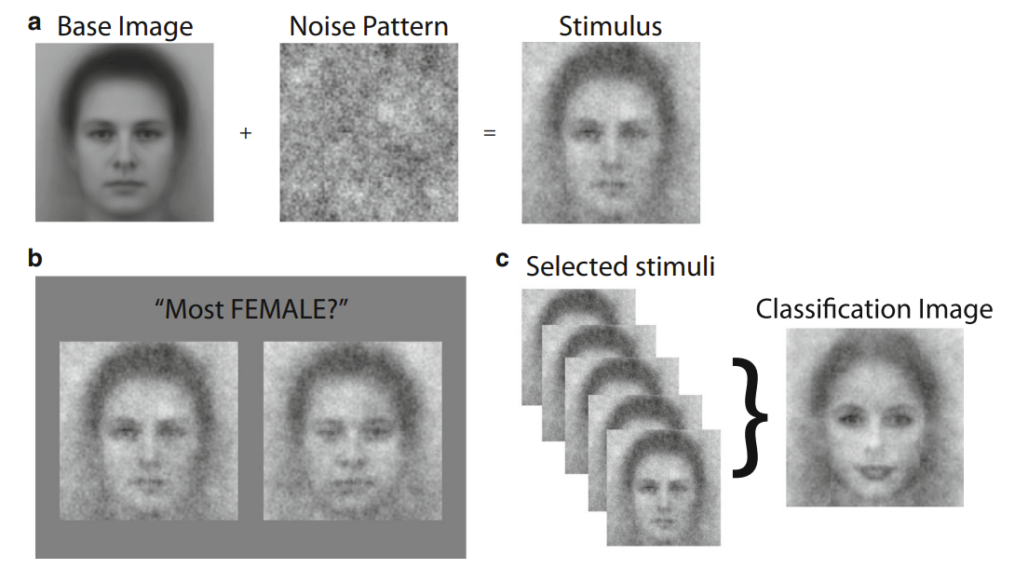

Slide 11
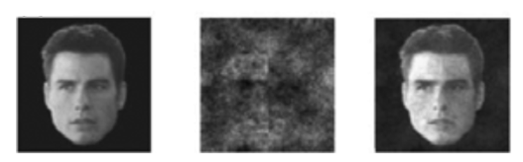
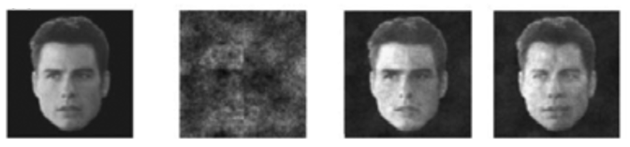

Slide 12
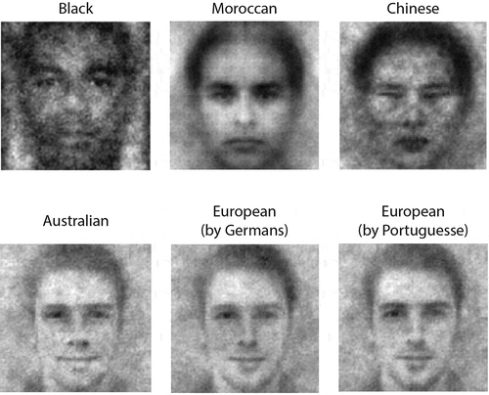

Slide 13
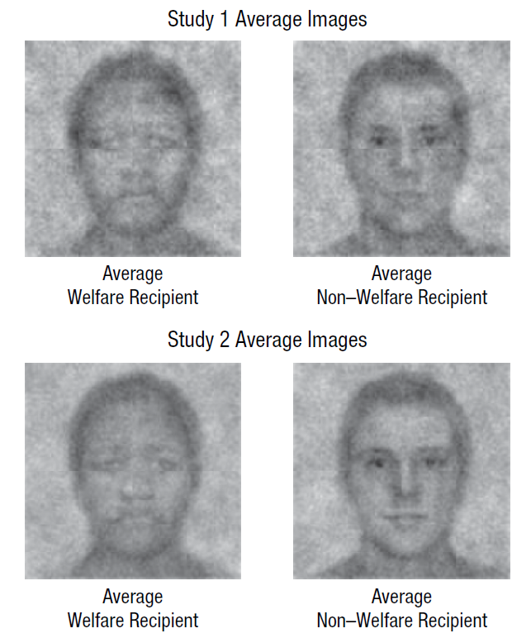

Slide 14
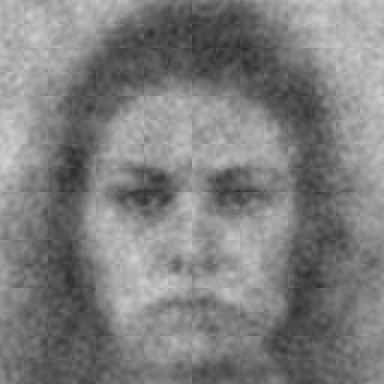
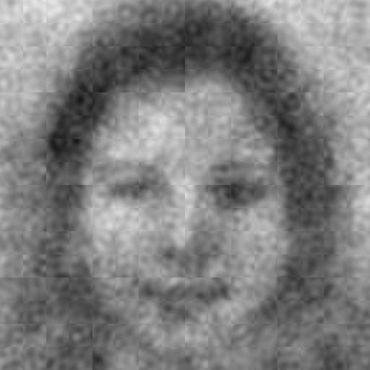
Results
Confronter
Non-Confronter

Slide 15
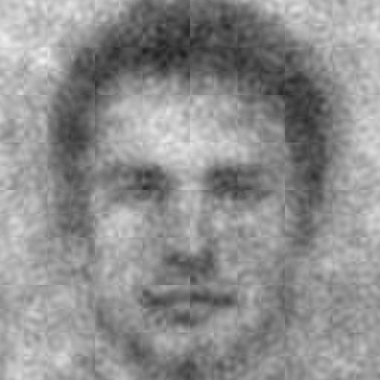
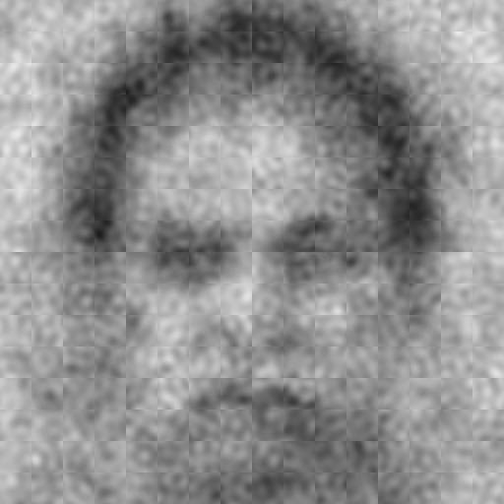
Results for a male confronter or non-confronter
Confronter
Non-Confronter

Slide 16
Mouse-tracking
Motor movements continuously adjusted to underlying cognitive processes
MouseTracker
Real-time cursor position
Time between mouse movements
Two options, solve cognitive conflict
Records changes in mental processes

Slide 17
START

Slide 18
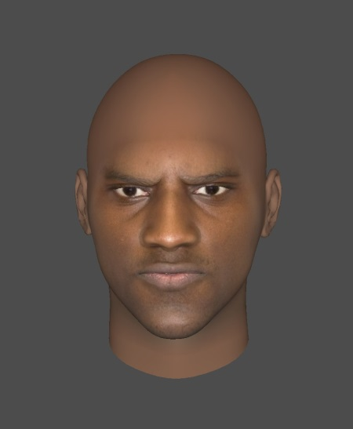
HAPPINESS
ANGER
Area Under the Curve
(AUC)
START

Slide 19
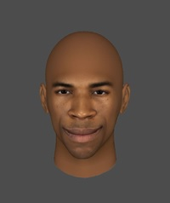
HAPPINESS
ANGER
START

Slide 20
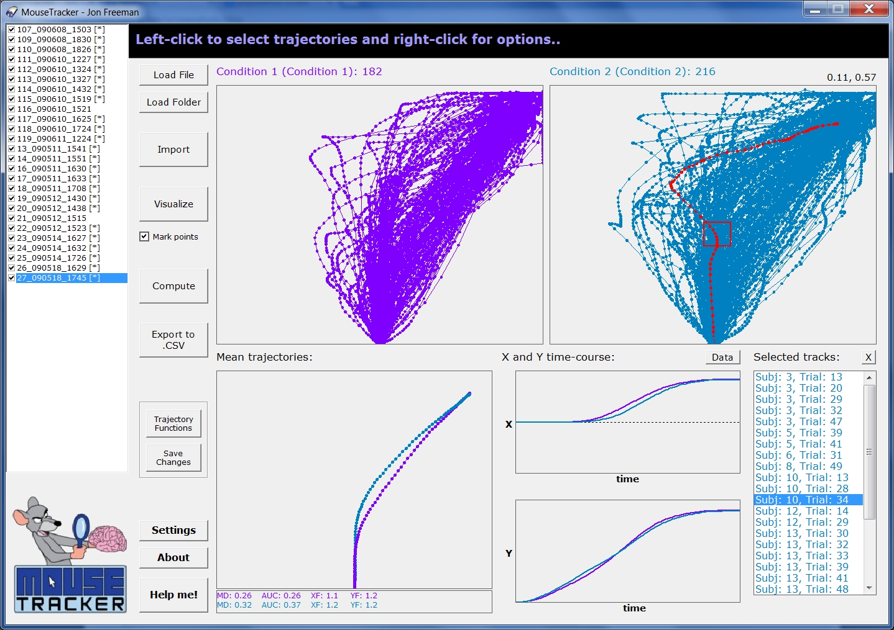

Slide 21
ANGER
FEAR

Slide 22
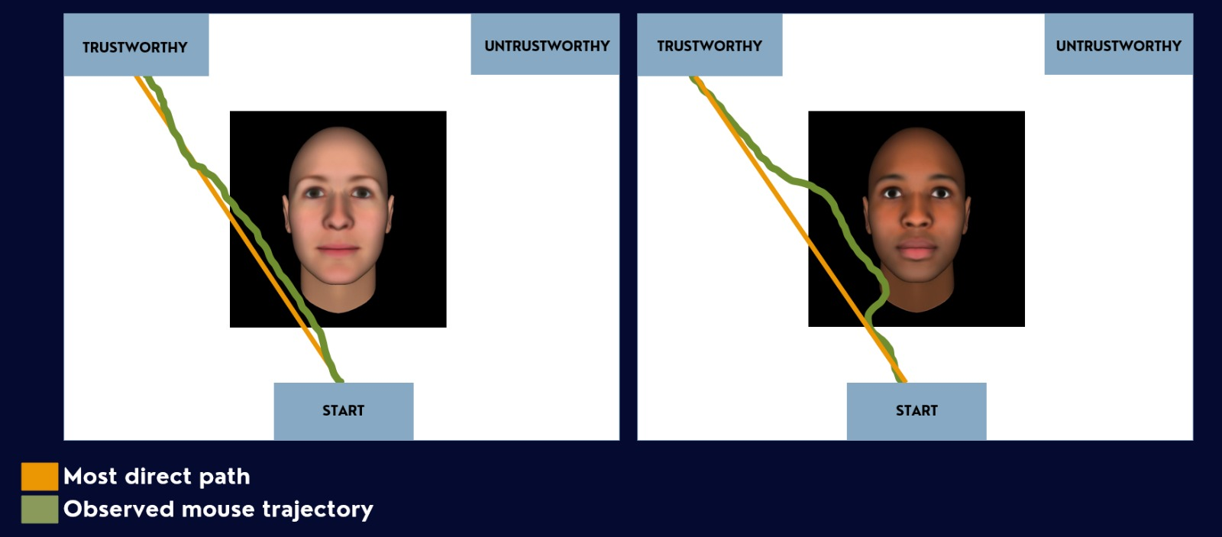

Slide 23
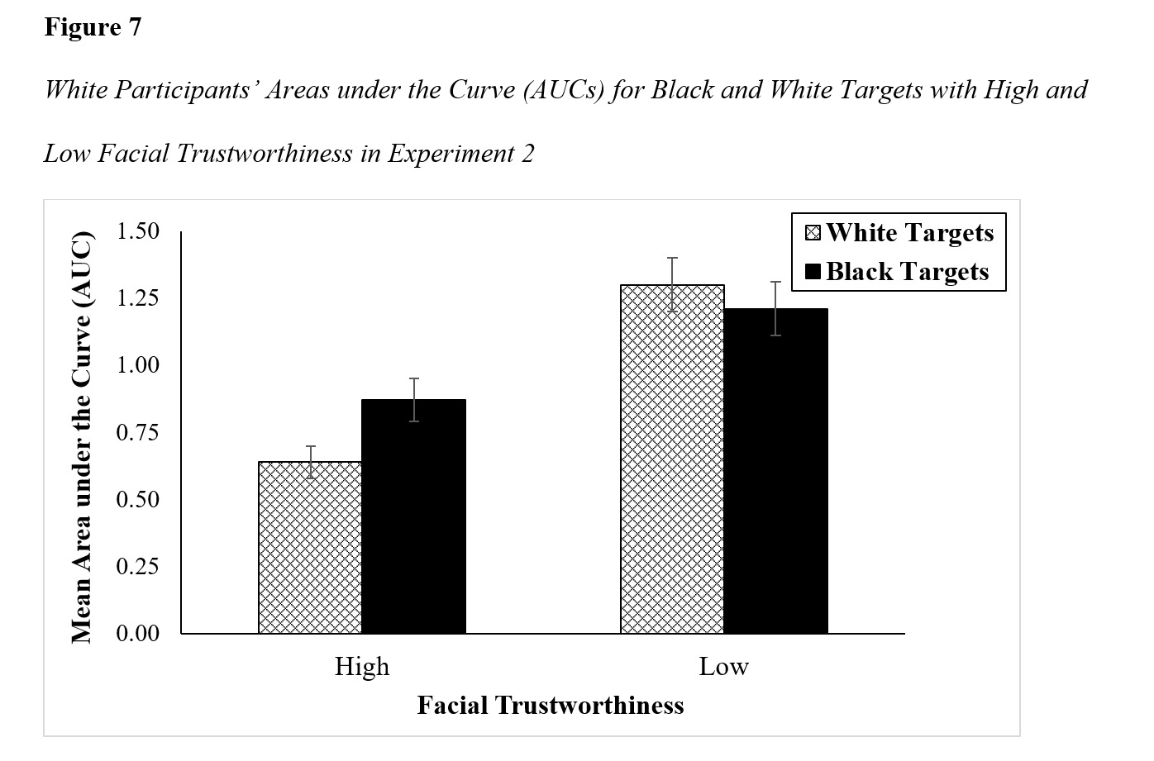

Slide 24
Conclusion
Traditional social cognition methods
May not be effective ways of visualizing biases
Are vulnerable to social desirability bias
May not show how judgements unfold in real time
New methods can capture implicit processes and dynamic decision making

Slide 25
Conclusion
Reverse correlation
Reveals mental images and stereotypes
Aggregates visual noise patterns to reveal implicit mental representations
Mousetracking
Captures real-time movements during decision-making
Tracks continuous hand movements from start to finish
Reveals conflict, hesitation, and decision-making processes

Slide 26
Thank you!
Questions?

